Slide 1
OOPS

Slide 2
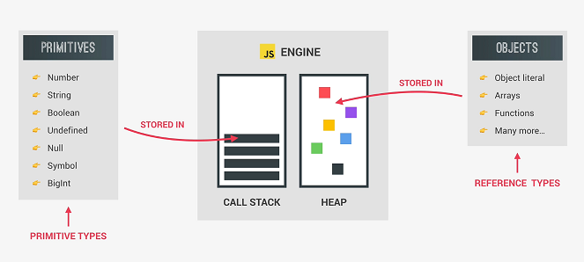
Datatypes:

Slide 3
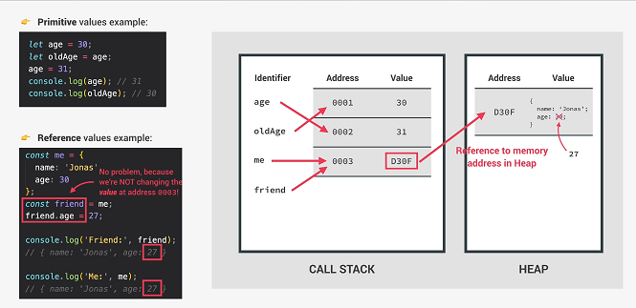
Primitive vs Reference Types

Slide 4
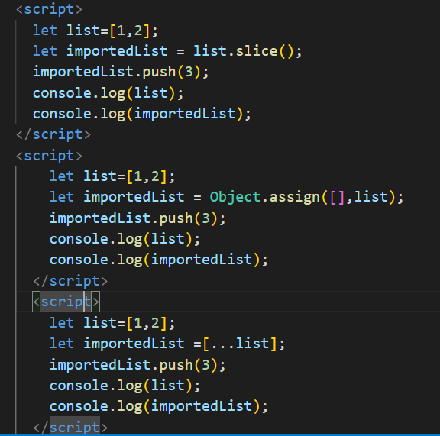
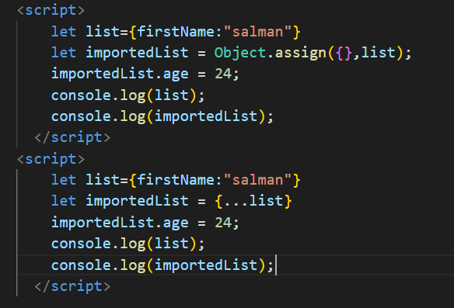
Deep copy of Array and Object

Slide 5
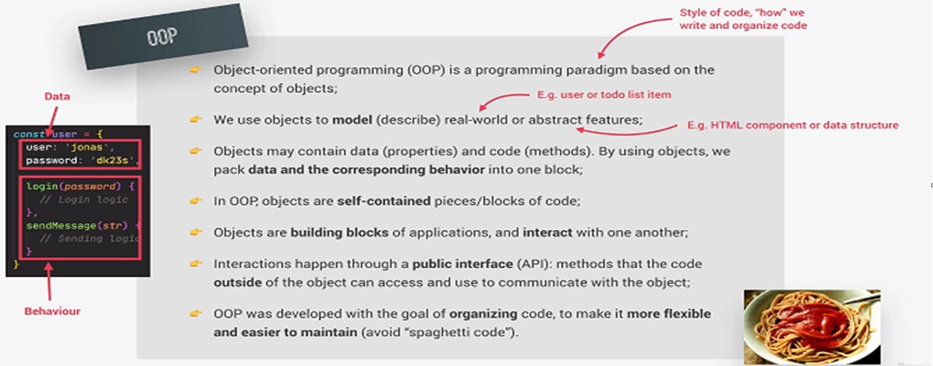
Object Oriented Programming

Slide 6
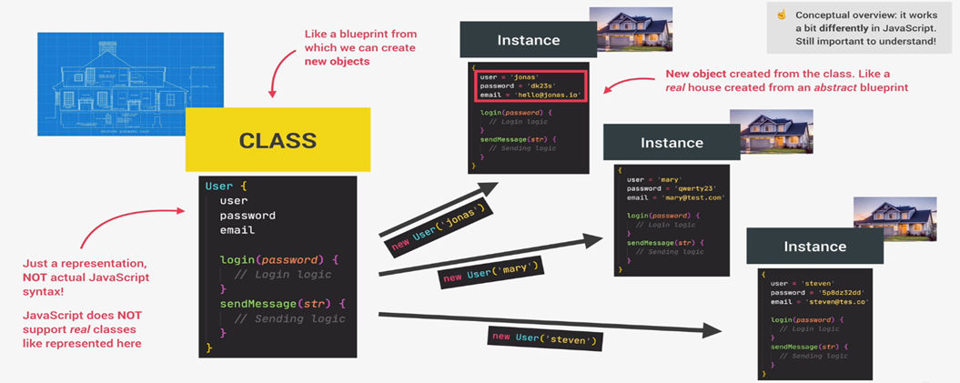
Classes And Instances

Slide 7
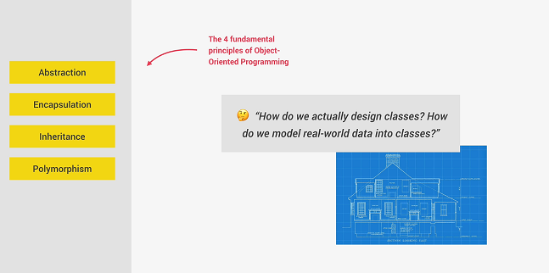
Fundamental of OOPS

Slide 8
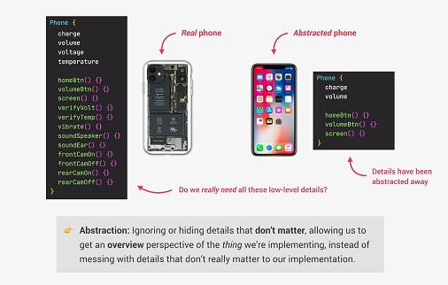
Abstraction

Slide 9
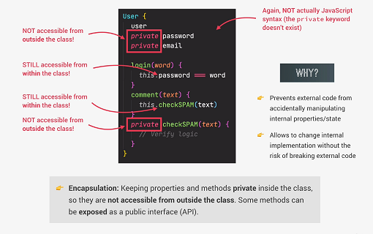
Encapsulation

Slide 10
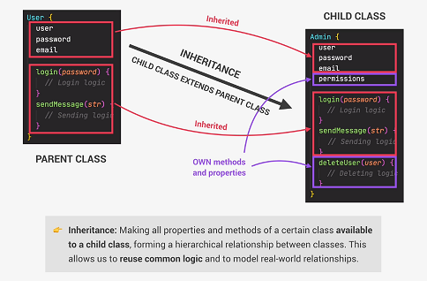
Inheritance

Slide 11
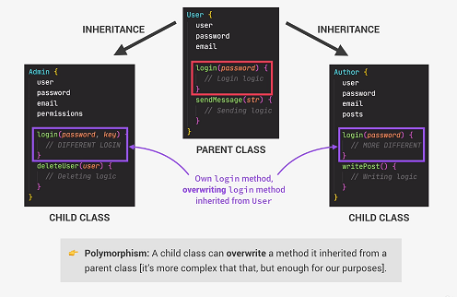
Polymorphism

Slide 12
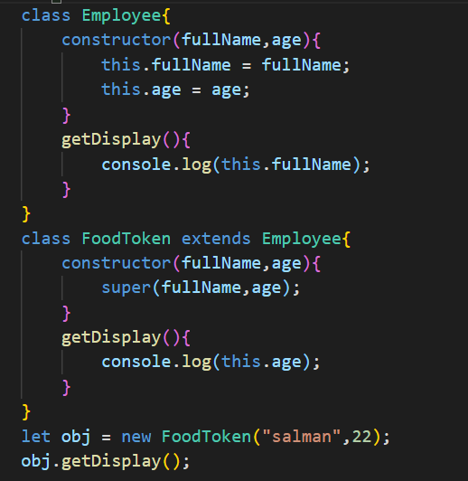
Polymorphism

Slide 13
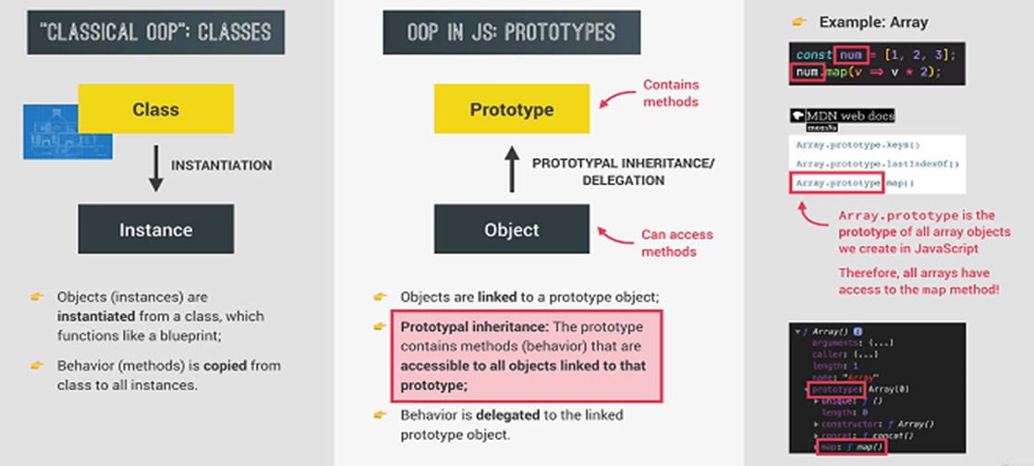
OOPS in Javascript

Slide 14
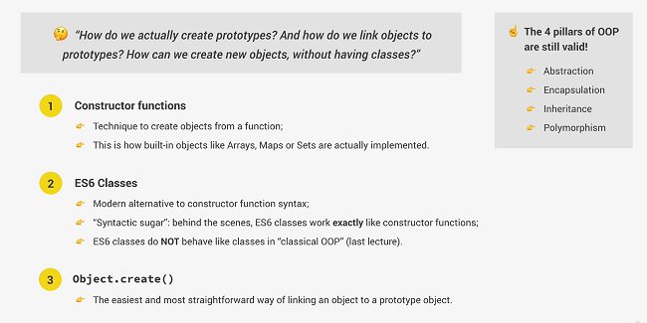
3 Ways of Implementing Prototypal Inheritance in Javascript

Slide 15
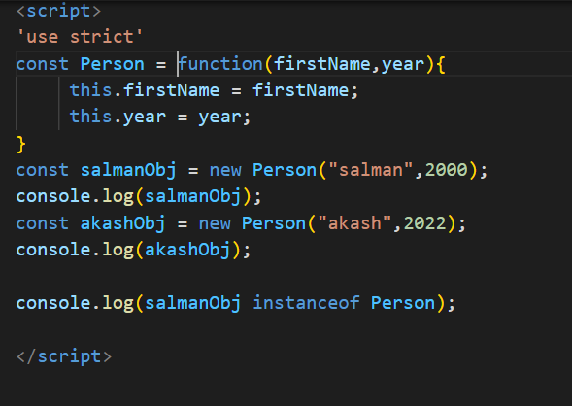
1.Constructor Function

Slide 16
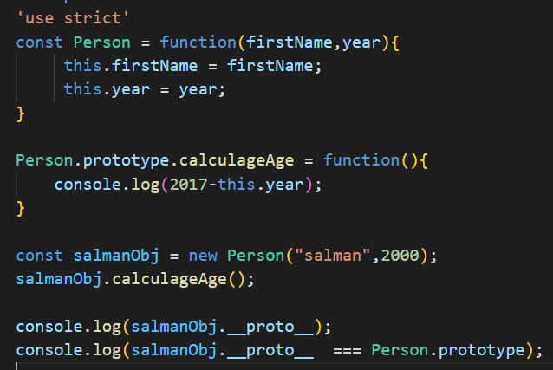
Prototypes

Slide 17
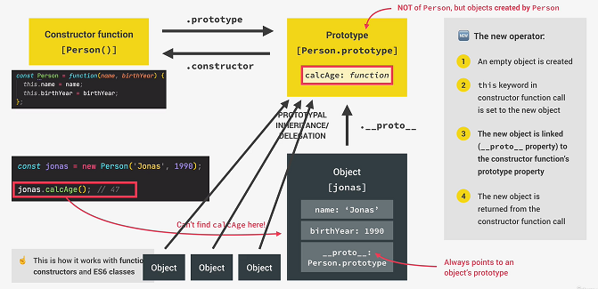
How Prototypal Inheritance

Slide 18
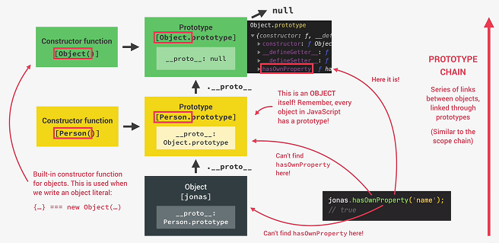
Prototype Chain

Slide 19
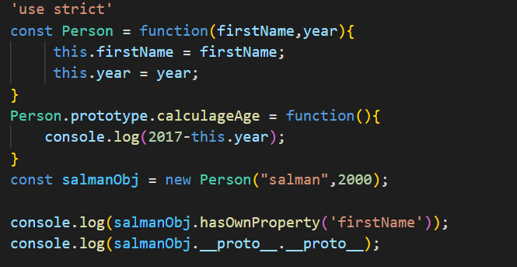
Prototypal Inheritance on Built in Objects

Slide 20
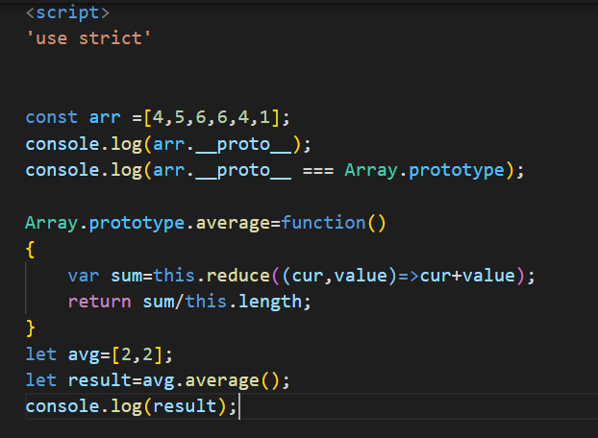
Prototypal Inheritance on Built in Objects

Slide 21
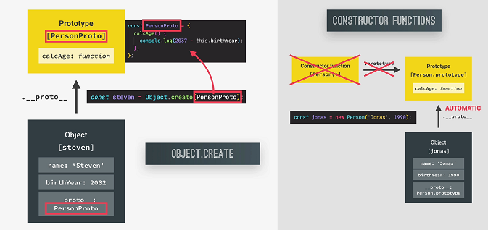
3.How Object.create Works

Slide 22
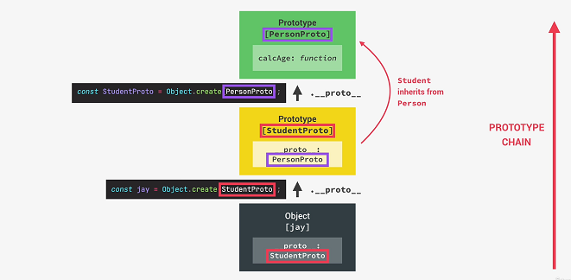
Inheritance in Object.create

Slide 23
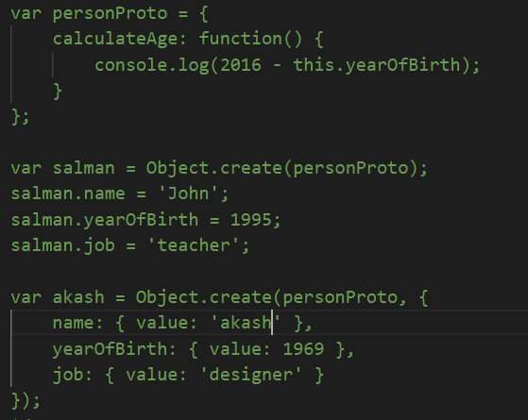
Inheritance – Object.create

Slide 24
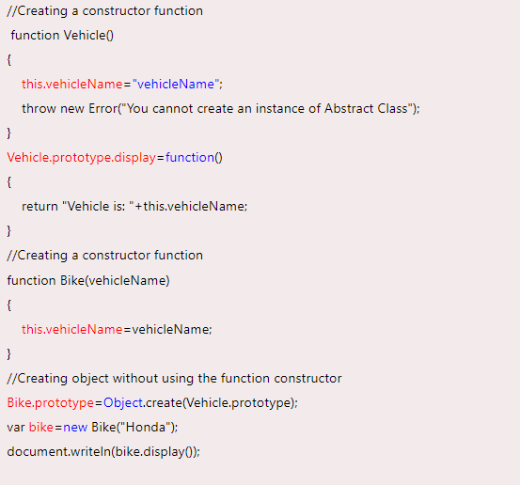
Abstraction

Slide 25
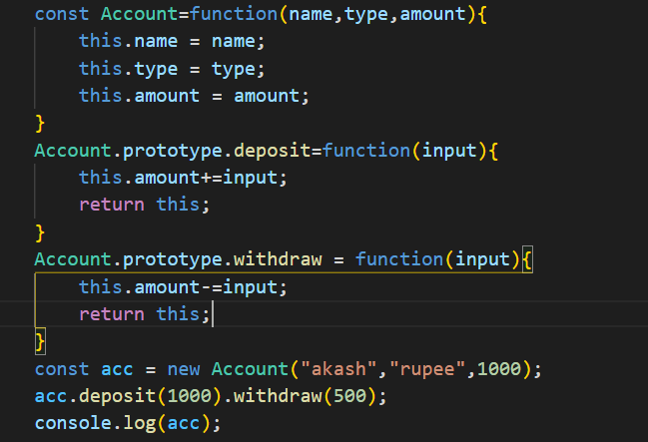
Chaining Methods

